Slide 1

UE22EC351B
TRANSMISSION LINES, WAVEGUIDES, AND ANTENNAS
Prof. Prajeesha
Department of Electronics and Communication Engineering

Slide 2
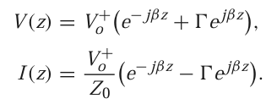
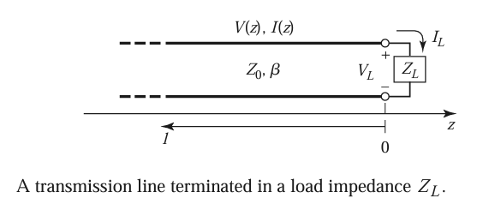
POWER FLOW IN Tx. LINES
The total voltage and current waves on the line can be written as
The voltage and current on the line consist of a superposition of an incident and a reflected wave, such waves are called standing waves.

Slide 3

POWER FLOW IN Tx. LINES
Assumes that the generator is matched so that there is no re-reflection of the reflected wave from z < 0.
Consider the time-average power flow along the line at the point z:
The middle two terms in the brackets are of the form A−A∗= 2j Im{A} and so are purely imaginary. This simplifies the result to

Slide 4


POWER FLOW IN Tx. LINES
The average power flow is constant at any point on the line and the total power delivered to the load (Pavg) is equal to the incident power minus the reflected power.
Pavg = -
If Г= 0, maximum power is delivered to the load, while no power is delivered for | Г |=1.

